Slide 1

DATA STRUCTURE
http://www.free-powerpoint-templates-design.com

Slide 2
Welcome!!
ERP(ENTERPRISE RESOURCE PLANNING

Slide 3
SUBMITTED BY
PAKIZA AMIR (0035)
BILAL AHMED(0037)
SHEHRYAR MANSOOR(0003)
ATEEQ QAISER(0018)
ZEESHAN SALEEM(0019)

Slide 4
SUBMITTED TO
PROF.SYED ALI SHAHID

Slide 5


Slide 6
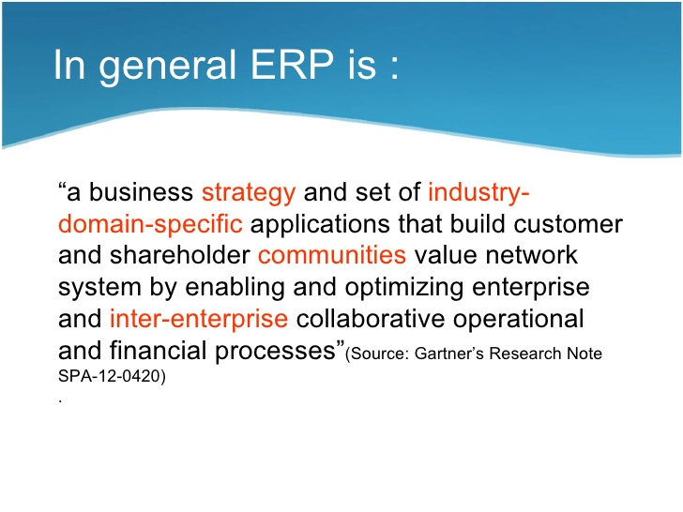
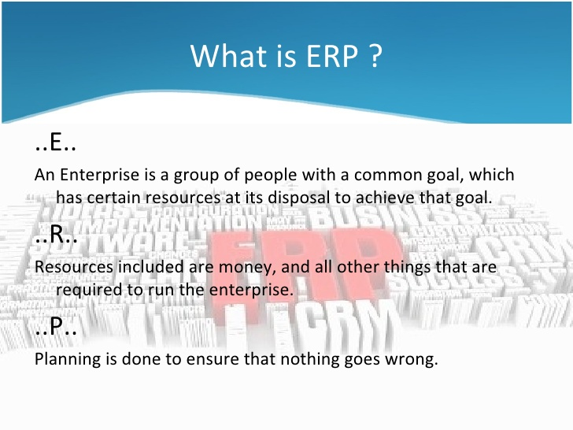

Slide 7
Goal of ERP
The goal of our enterprise is simply to get, keep, and grow customers.
GET Acquire profitable customers
KEEP Retain profitable customers longer.• Win back profitable customers•
Eliminate unprofitable customers
GROW Up sell additional products in a solution•
Cross sell other products to customers•
Reduce service and operations cost.

Slide 8
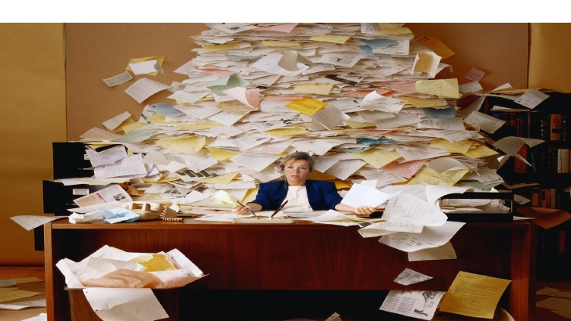

Slide 9
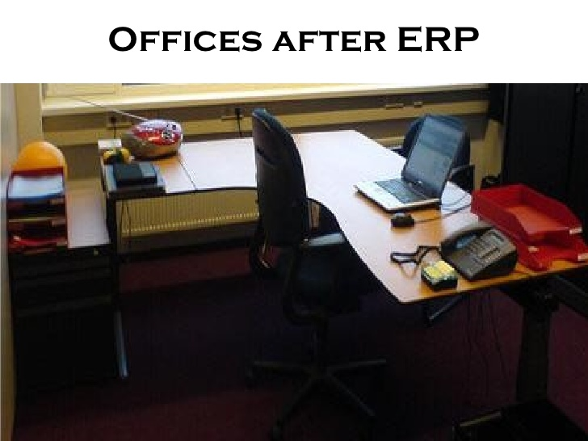

Slide 10
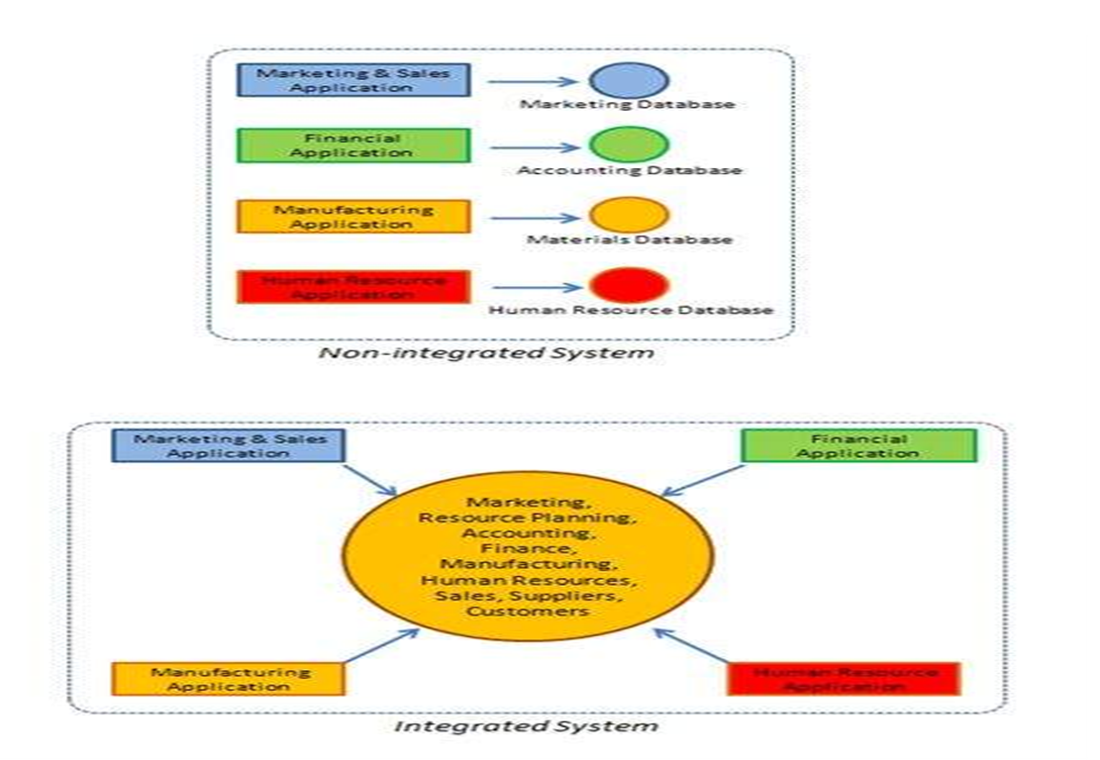
COMPARISON

Slide 11
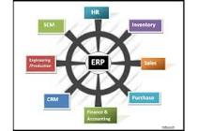
MAIN MODULES
Human Resource
Inventory
Sales & Marketing
Purchase
Finance & Accounting
Customer Relationship Management(CRM)
Engineering/ Production
Supply Chain Management (SCM)

Slide 12
OUR MODULE
SUPLLIER
AND CUSTOMER
DETAIL

Slide 13
REQUIREMENTS
We want to be good customers to our suppliers, good providers to our customers and earn a profit at the same time
All the details

Slide 14
Main features
Insert
Add
Update
Delete
Meets all details
Customer requirements
Supplier and customer relationship
Customer future demand
Supplier demands
Full integrated environment

Slide 15
Continued
Now lets move toward the program and practical implementation of our module

Slide 16
Thank you

